Slide 1

NBA Draft Combine Measurements Analysis
Data analytics
BY:- BHAVIK JAIN

Slide 2
INTRODUCTION
Objective:
To analyze the NBA Draft Combine measurements dataset
Uncover key insights
Relationships between various physical attributes of players over different years.
Tools Used:
Python
Pandas
Numpy
Matplotlib
Seaborn

Slide 3
METHODOLOGY
1. Data Loading and Exploration
Loaded the dataset using pandas.
Basic exploration techniques to understand the structure and summary statistics of the data.
2. Year-Wise Comparison
Grouped the dataset by year.
Calculated the mean values of all numeric columns for each year.
3. Data Visualization
Correlation matrix heatmap.
Scatter plots to analyze relationships between key attributes.

Slide 4
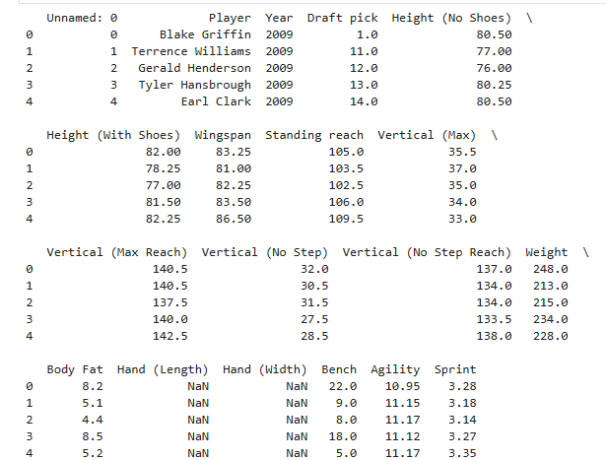
DATA LOADING AND EXPLORATION
Displayed first few rows to understand data structure.
Used info() to get an overview of the dataframe, including data types and non-null counts.
Used describe() to get summary statistics of numeric columns.

Slide 5
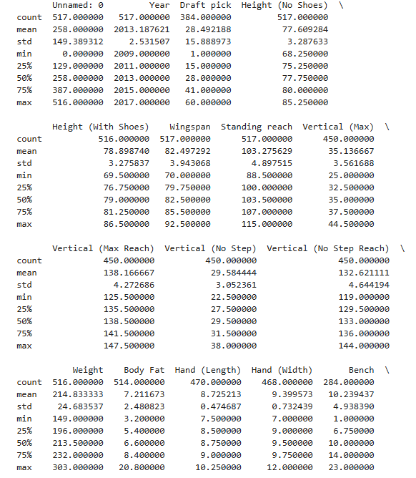
YEAR-WISE COMPARISON
Grouped data by ‘Year’ and calculated mean values for each numeric attribute.
Helped understand how player measurements evolved over the years

Slide 6
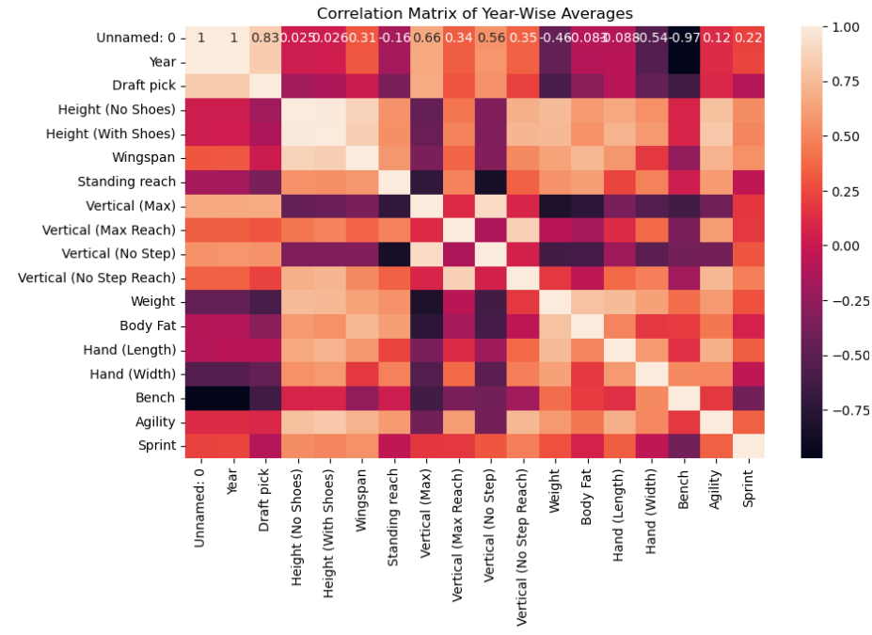
CORRELATION MATRIX VISUALIZATION
Heatmap visualizes correlations between different measurements on a year-wise average basis.
Strong correlations observed between height, wingspan, and standing reach

Slide 7
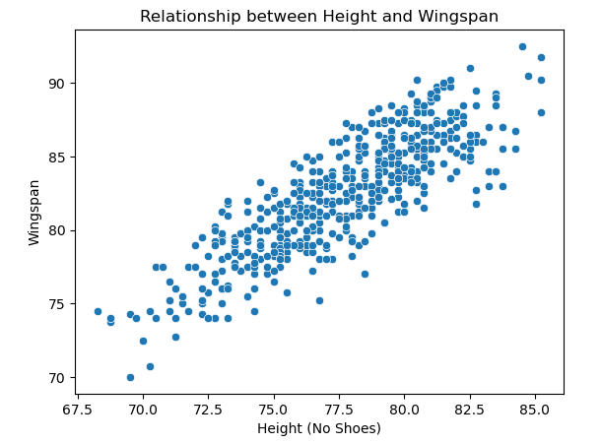
RELATIONSHIP BETWEEN HEIGHT AND WINGSPAN
Scatter plot shows a positive relationship between height (without shoes) and wingspan.
Taller players tend to have longer wingspans.

Slide 8
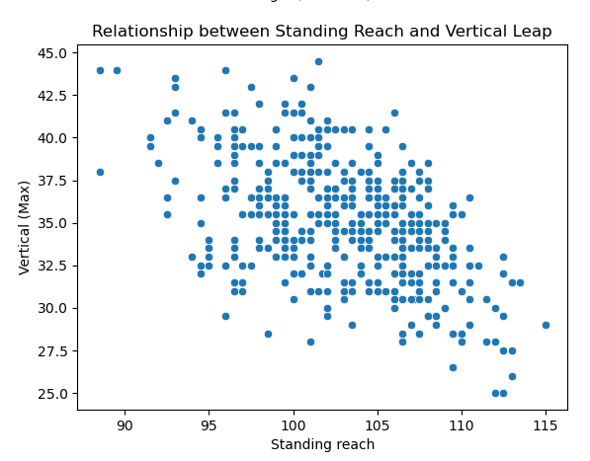
Relationship Between Standing Reach And Vertical Leap
Scatter plot shows the relationship between standing reach and maximum vertical leap.
Insights into how standing reach might affect a player's jumping ability

Slide 9
KEY INSIGHTS
1. Evolution of Player Measurements:
Significant changes in average player measurements over the years.
Reflects evolving player profiles and training regimens.
2. Correlations between Attributes:
Height, wingspan, and standing reach show strong correlations.
Taller players generally have longer wingspans and higher standing reaches.
3. Height vs. Wingspan:
Positive relationship between height and wingspan.
4. Standing Reach vs. Vertical Leap:
Standing reach not necessarily correlated with higher vertical leaps.

Slide 10
RECOMMENDATIONS
1. Player Selection:
Use insights to better assess player potential based on physical measurements.
2. Training Focus:
Tailor training programs to improve attributes like vertical leap, which are less correlated with inherent physical traits.
3. Future Data Collection:
Continue collecting detailed combine measurements to track trends and changes in player profiles over time.
4. Further Research:
Investigate other factors influencing vertical leap and other performance metrics

Slide 11
CONCLUSION
The analysis provides valuable insights into the physical profiles of NBA draft combine participants.
Helps in better player assessment and training optimization.
Future work can expand on these findings to include more variables and deeper analysis.

Slide 12
THANK YOU

